Slide 1
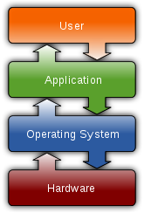
WHAT IS OPERATING SYSTEM
An operating system (OS) is system software that manages computer hardware and software resources and provides common services for computer programs.
For hardware functions such as input and output and memory allocation, the operating system acts as an intermediary between programs and the computer hardware.
There are many operating systems such as macOS, Linux, and Microsoft Windows.

Slide 2
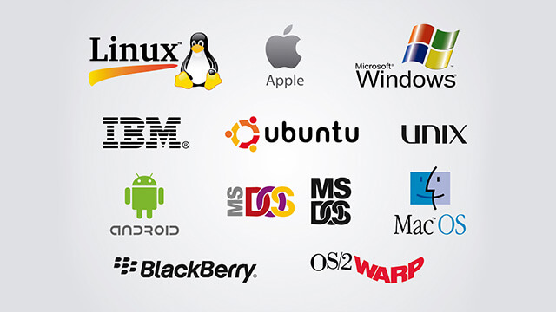
TYPES OF OPERATING SYSTEM
Real-time operating systems (RTOS)
Single-user, single-task
Single-user, multi-tasking
Multi-user

Slide 3
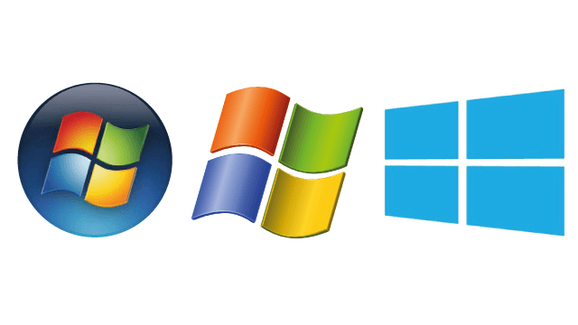
WINDOWS OPERATING SYSTEM
Windows OS, computer operating system (OS) developed by Microsoft Corporation to run personal computers (PCs).
Featuring the first graphical user interface (GUI) for IBM-compatible PCs, the Windows OS soon dominated the PC market.

Slide 4
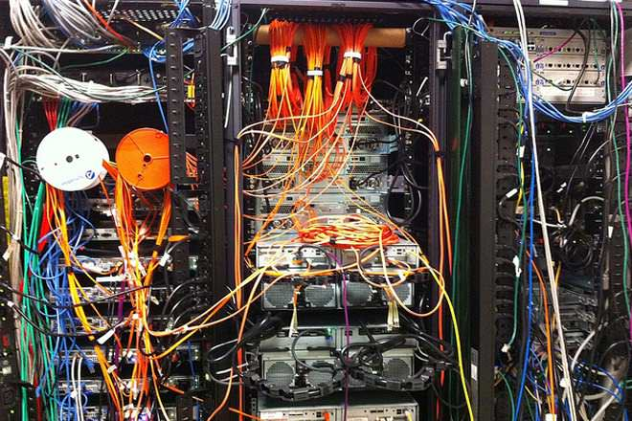
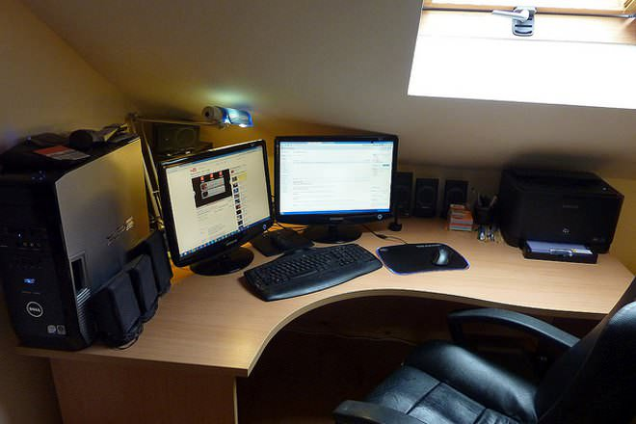
Windows Workstation vs Windows Server
Windows Server Supports More Memory.
Windows Server Uses CPUs More Efficiently.
More Network Connections Allowed on a Windows Server.
The Server OS is Configured for Background Tasks.

Slide 5
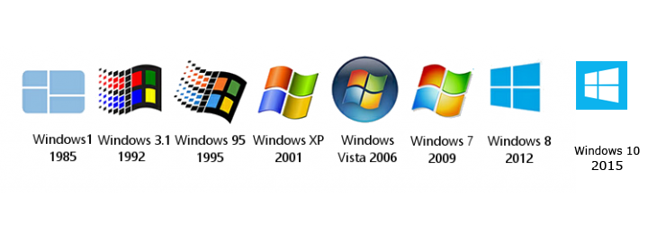
Versions of Windows Workstation

Slide 6
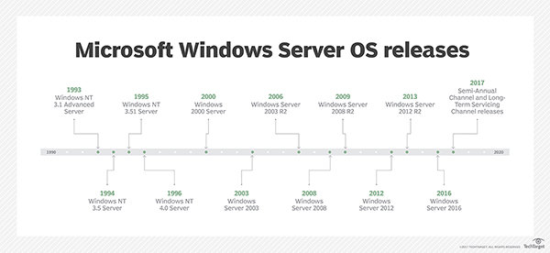

Slide 7
Features of Windows 7 and Server 2008 R2
Direct Access
Read only Distributed File System (DFS)
Desktop and Application Feeds
Agile VPN
Offline Folders enhancements
AppLocker
RDP 7

